Slide 1
STANDARDS-BASED IEP
SECONDARY STUDENT

Slide 2
Standards & Curriculum Guides
Alabama College - & Career – Ready Standards
http://alex.state.al.us/ccrs/
http://alex.state.al.us/specialed/
http://www.alsde.edu/home/
Notes:
The following is an overview of the standards and curriculum guides.
Alabama College & Career Ready Standards: The Alabama State Board of Education
Approved combining Common Core Standards with selected Alabama Standards to develop a comprehensive set of standards for our state;
Designed to communicate what students are expected to know and be able to do in a particular subject area by the end of each grade level.
Minimum content is outlined.
These are accessed from the Alabama State Department of Education website by clicking on the College & Career Ready Standards (CCRS) link.

Slide 3
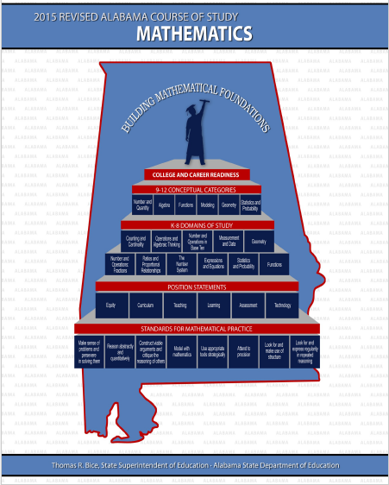

Algebra I - Quantities

Slide 4
Standards & Curriculum Guides
Alabama College - & Career – Ready Standards
Alabama Curriculum Guides
http://alex.state.al.us/ccrs/
http://alex.state.al.us/specialed/
http://www.alsde.edu/home/
Notes:
Alabama Curriculum Guides:
Designed for students who are not performing at grade level
Can be used to pre-assess skills and develop classroom instruction to close the gap between the grade-level content and the student’s instructional level;
Include objectives that are prerequisite to the standard – that may be taught to help students access grade-level content standards that were missed in an earlier grade;
Breaks the standard down into smaller instructional units

Slide 5

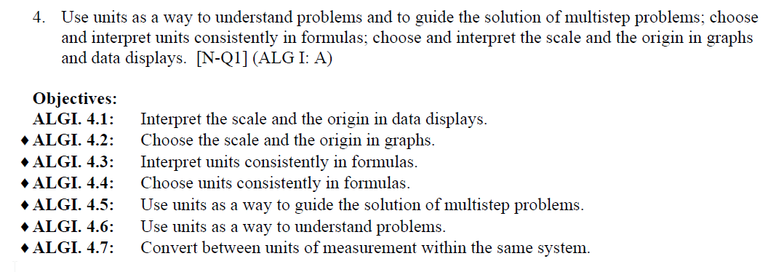
Algebra I - Quantities

Slide 6
Standards & Curriculum Guides
Alabama College - & Career – Ready Standards
Alabama Curriculum Guides
Alabama Extended Standards
http://alex.state.al.us/ccrs/
http://alex.state.al.us/specialed/
http://www.alsde.edu/home/
Notes:
Alabama Extended Standards: Aligned to the new Alabama College and Career Ready Standards;
Extensions of the state academic content standards for each grade level –
Clearly related to the grade-level content, but reduced in scope and complexity;
All academic areas represented: Reading, Math, Science, Social Studies, and English Language Arts;
Designed to allow students with significant cognitive disabilities to progress toward state standards while beginning at each student’s present level of performance

Slide 7
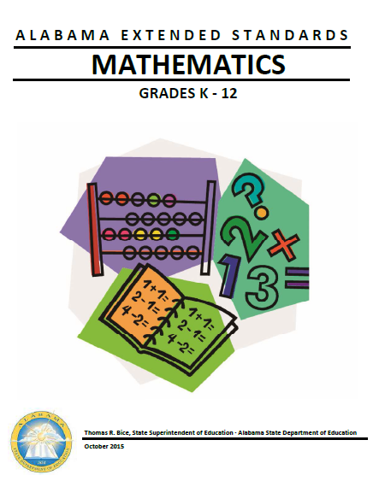
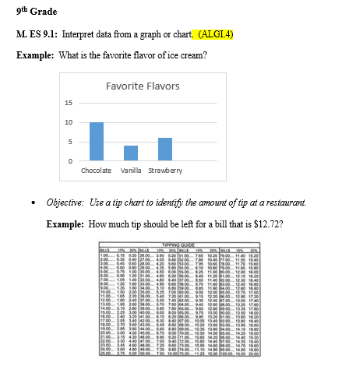

Slide 8
Standards & Curriculum Guides
Alabama College - & Career – Ready Standards
Alabama Curriculum Guides
Alabama Extended Standards
Alabama Transition Standards
http://alex.state.al.us/ccrs/
http://alex.state.al.us/specialed/
http://www.alsde.edu/home/
Notes:
Provide the framework for developing appropriate and meaningful transition goals.

Slide 9
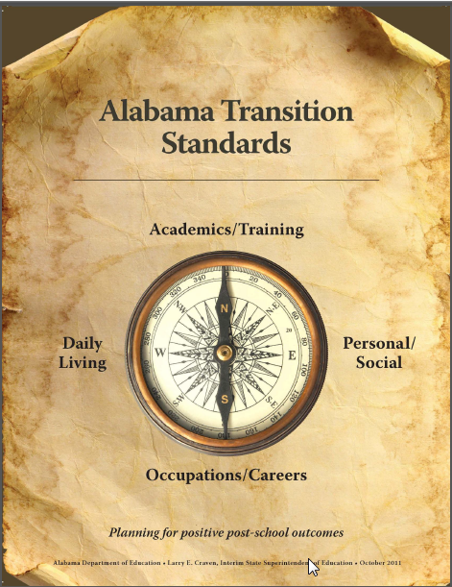
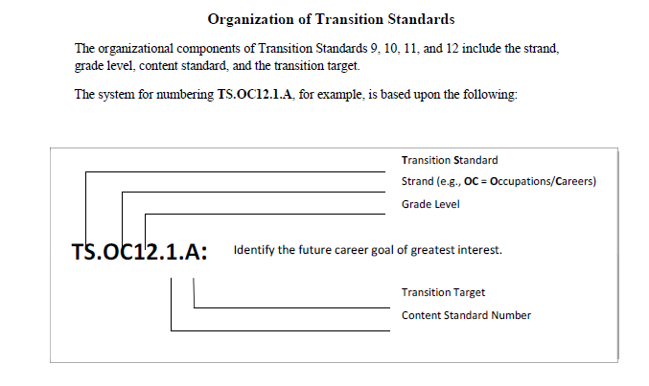
Notes:
Address the areas of academics/training; occupations/careers; personal/social; and daily living.
The standards listed by each grade level serve only as guideposts and should be tailored to fit for each individual student.
MUST be individualized. Thus, these standards must be interpreted and selected in a flexible, personally significant manner.
Remember: use the Alabama Transition Standards in developing and writing transition goals.

Slide 10
Standards & Curriculum Guides
Alabama College - & Career – Ready Standards
Alabama Curriculum Guides
Alabama Extended Standards
Alabama Transition Standards
Alabama Developmental Standards
  for Preschool Children
http://alex.state.al.us/ccrs/
http://alex.state.al.us/specialed/
http://www.alsde.edu/home/
Notes:
Alabama Developmental Standards for Preschool Children: Designed to be collectively reflective of the standards and curricula used in various preschool settings throughout the state

Slide 11

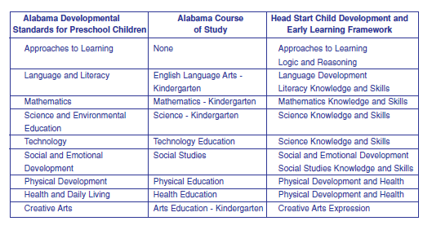
Notes:
Serve as a natural progression to the kindergarten standards contained in the Alabama Courses of Study
Describe outcomes desired for all children at the end of their preschool experience as they enter kindergarten
Reflects the philosophy of including children with disabilities in early childhood programs
The Alabama Developmental Standards for Preschool Children are grouped around nine areas of development. Goals and standards in the nine areas align with kindergarten standards found in the subject area Courses of Study developed by the State Department of Education and with the 2011 Head Start Child Development and Early Learning Framework.

Slide 12
Standards & Curriculum Guides
Alabama College - & Career – Ready Standards
Alabama Curriculum Guides
Alabama Extended Standards
Alabama Transition Standards
Alabama Developmental Standards
  for Preschool Children
http://alex.state.al.us/ccrs/
http://alex.state.al.us/specialed/
http://www.alsde.edu/home/

Slide 13
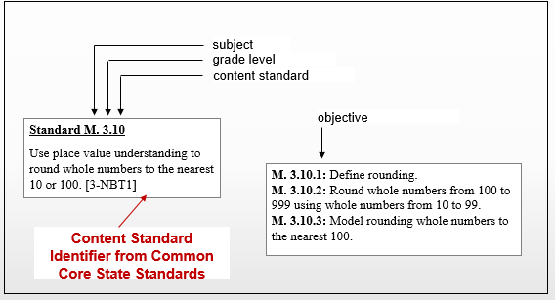
Notes:
To reference a standard in a measurable annual goal using this example: M. 3. 10.1 – which represents Math; 3rd grade; content standard 10; objective 1

Slide 14
PLEASE NOTE:
THE FOLLOWING EXAMPLE
IS ONLY ONE WAY
TO DEVELOP A STANDARDS-BASED IEP
DISCLAIMER
Notes:
PLEASE NOTE: THE FOLLOWING EXAMPLE IS ONLY ONE WAY
TO DEVELOP A STANDARDS BASED IEP

Slide 15
Notice and Invitation to a Meeting/
Consent for Agency Participation
STANDARDS-BASED IEP

Slide 16
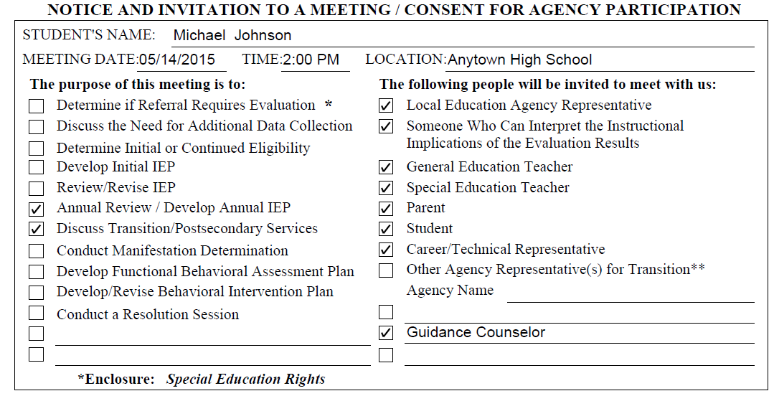

Slide 17
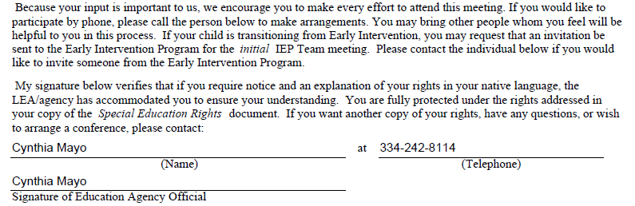

Slide 18
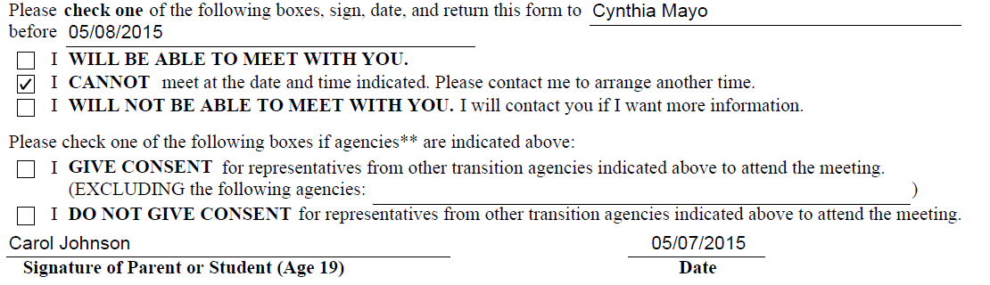

Slide 19
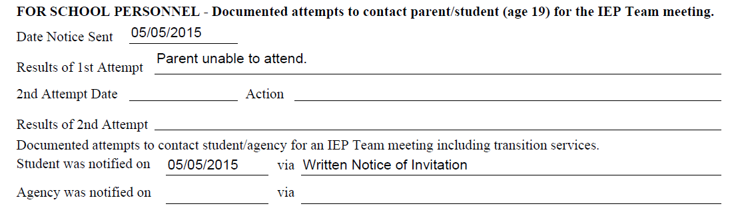

Slide 20
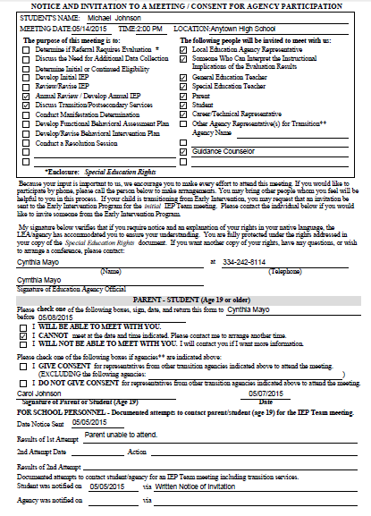
Complete Form and Close in SETS

Slide 21
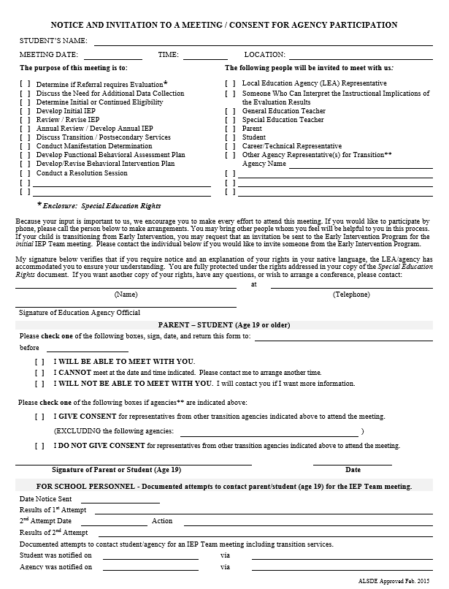
New Date/Time = New Meeting Notice

Slide 22
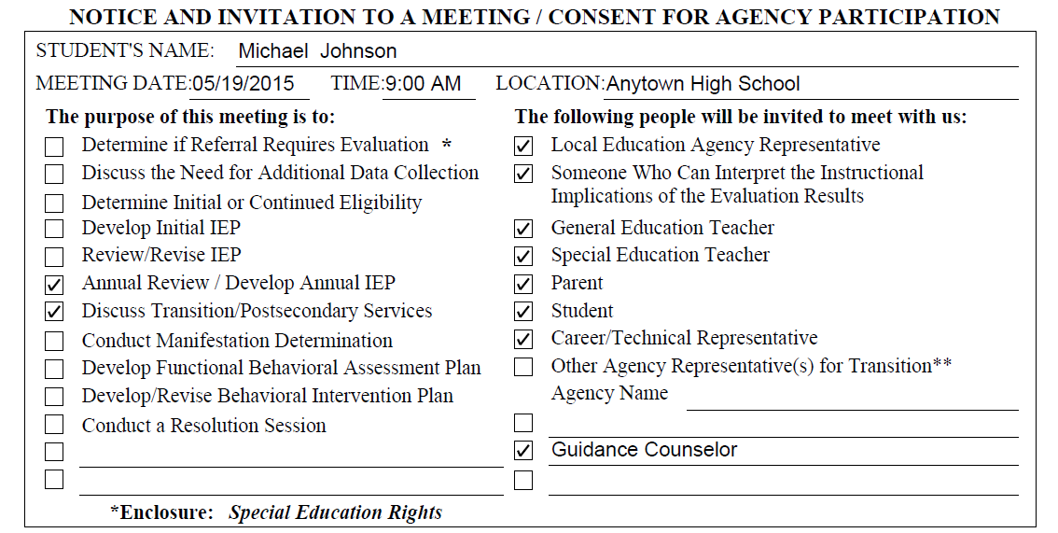

Slide 23
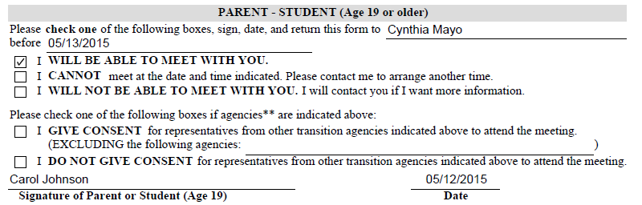

Slide 24
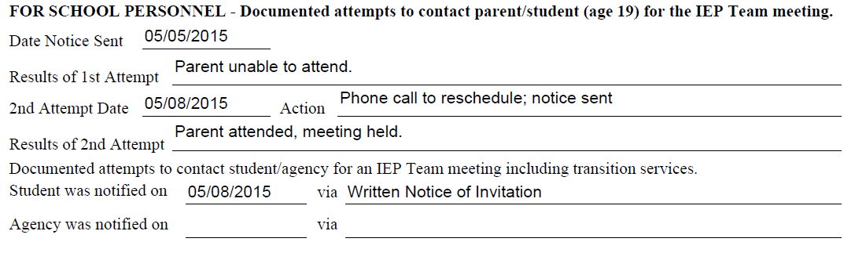

Slide 25
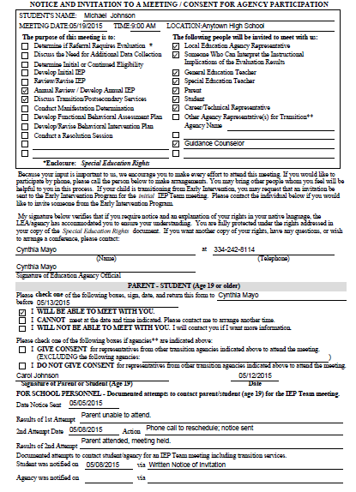

Slide 26
Profile Page
STANDARDS-BASED IEP

Slide 27
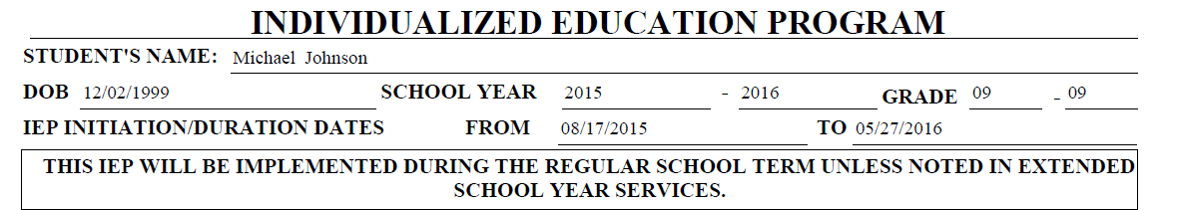

Slide 28
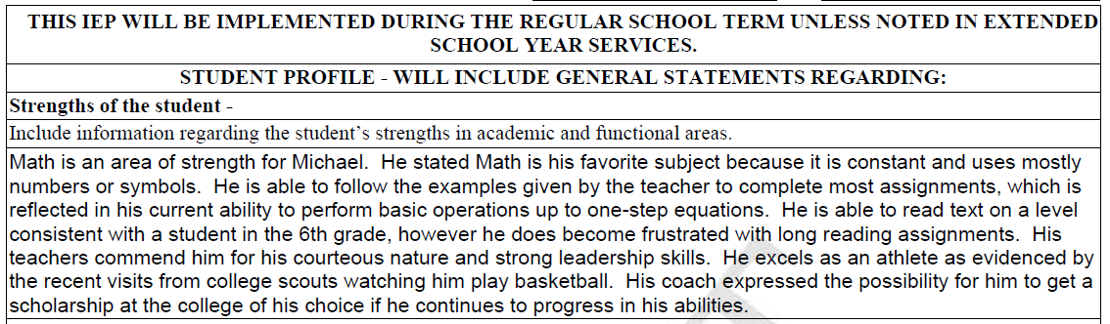

Slide 29
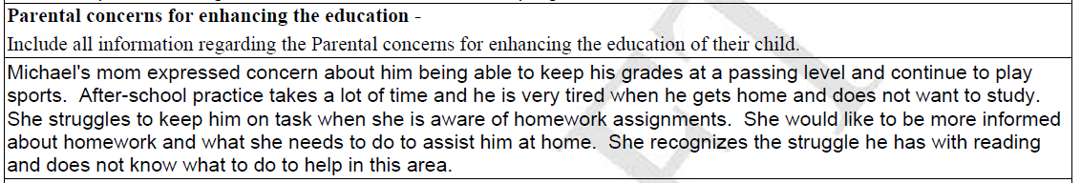

Slide 30
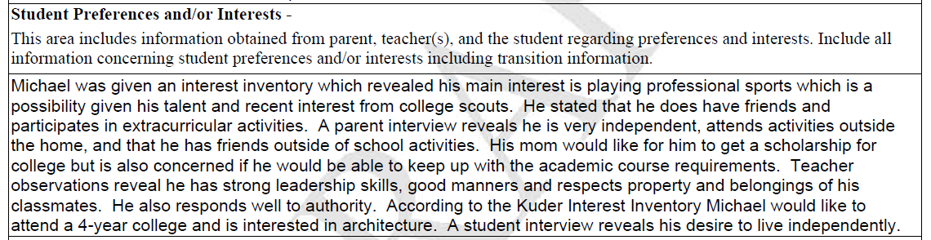

Slide 31
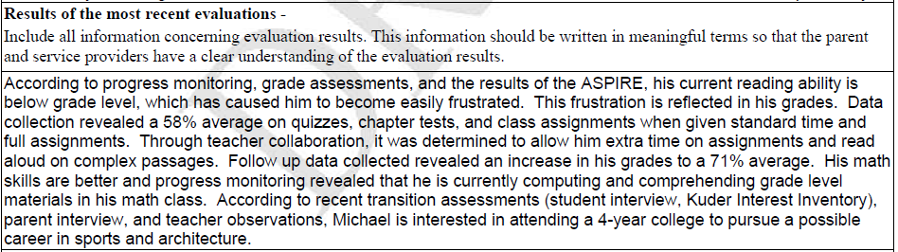

Slide 32
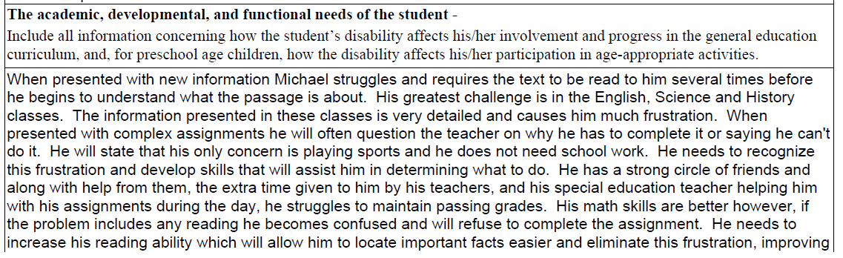

Slide 33
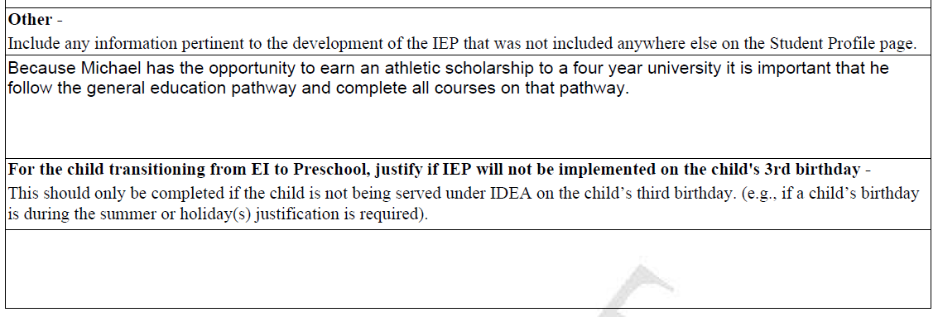

Slide 34
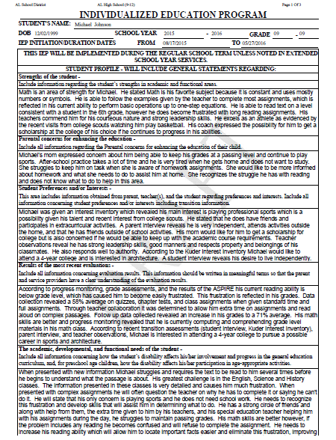
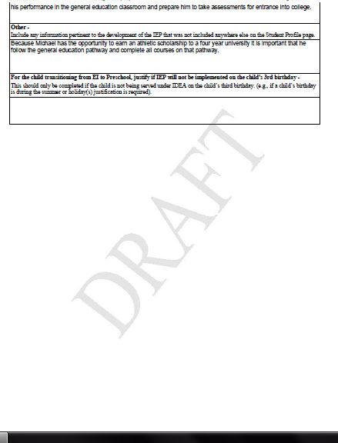

Slide 35
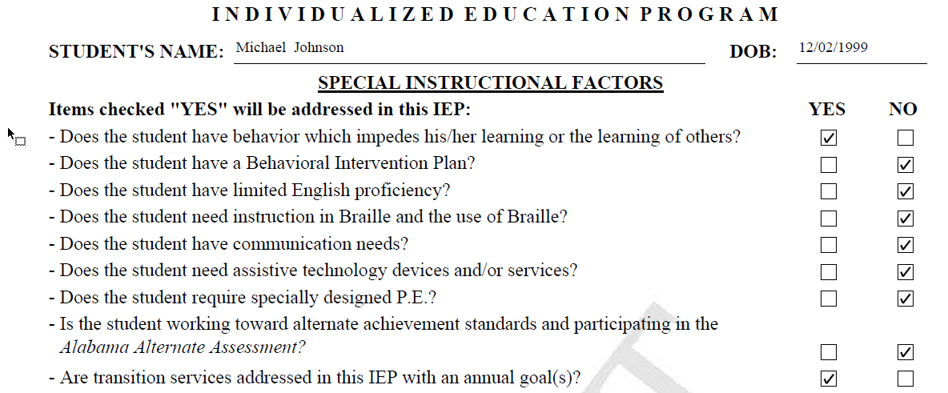

Slide 36
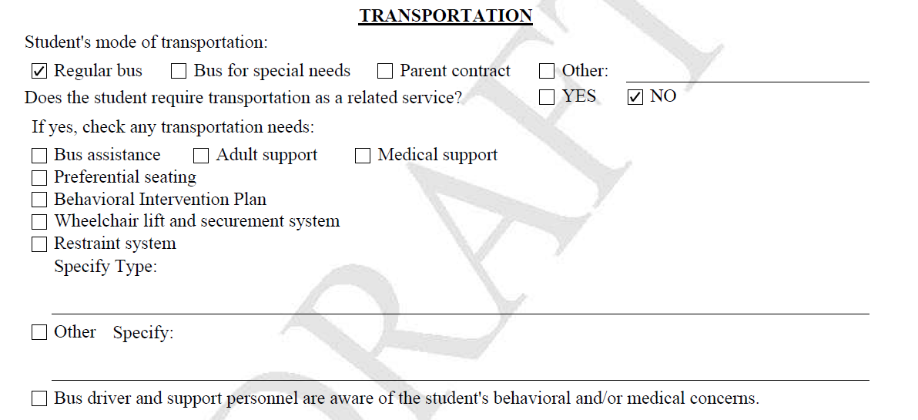

Slide 37
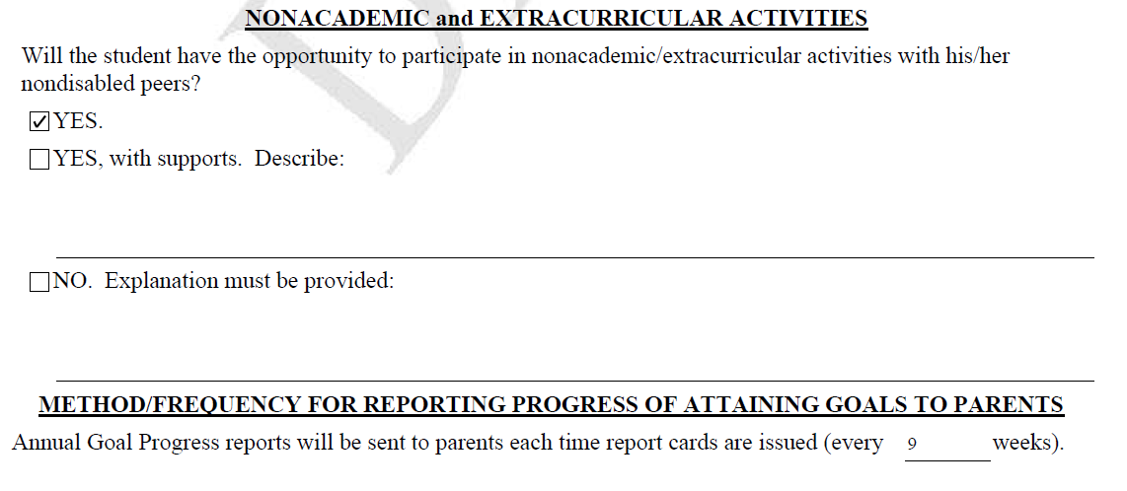

Slide 38
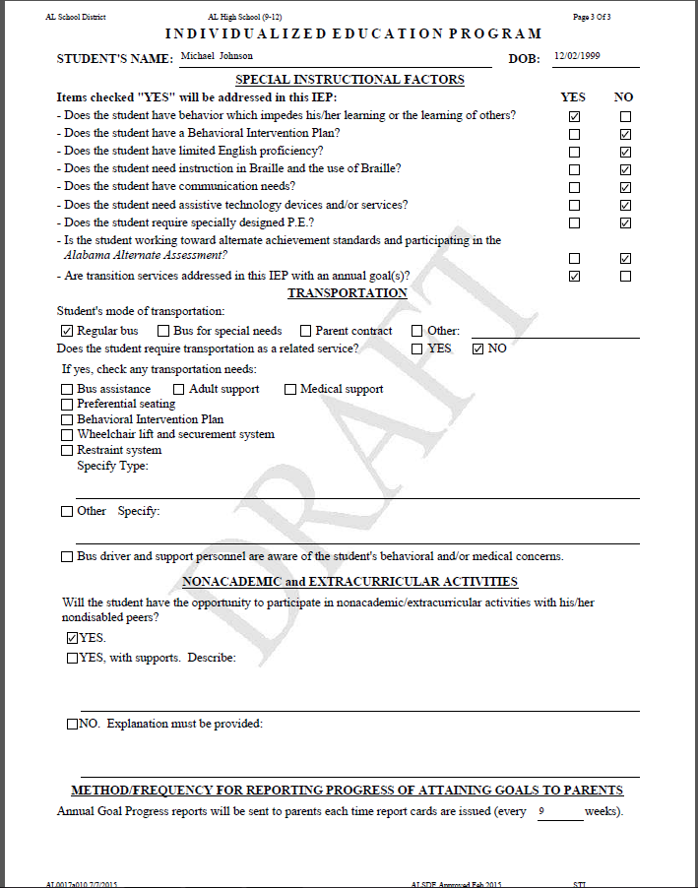

Slide 39
Transition
STANDARDS-BASED IEP
Notes:
Facilitator’s Notes:

Slide 40
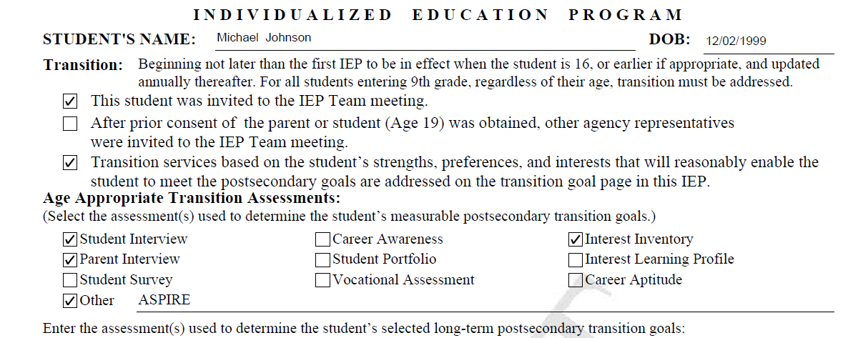

Slide 41
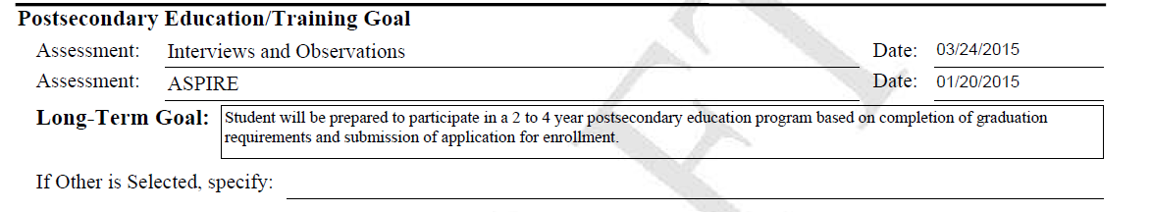

Slide 42
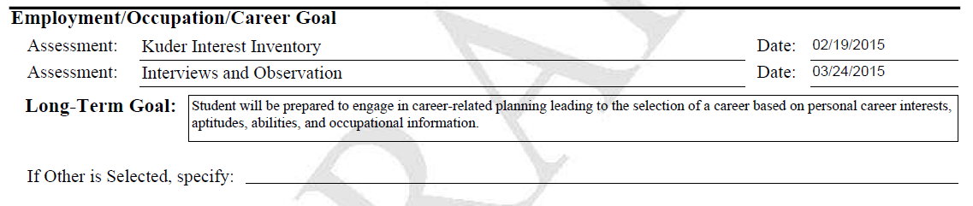

Slide 43
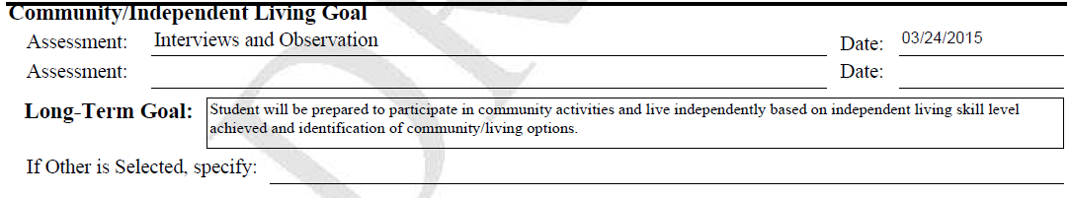

Slide 44
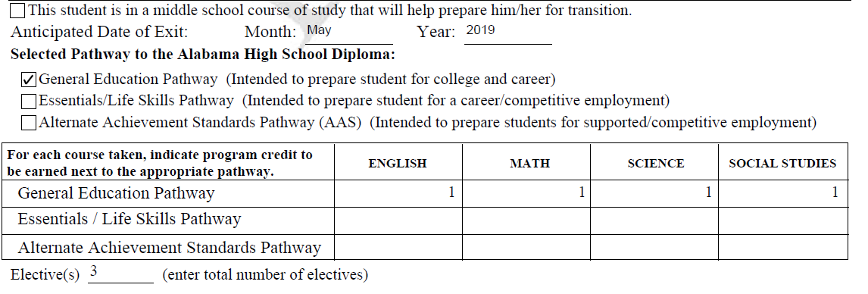

Slide 45
Annual Transition Goal Page(s)
STANDARDS-BASED IEP
Notes:
Facilitator’s Notes:

Slide 46
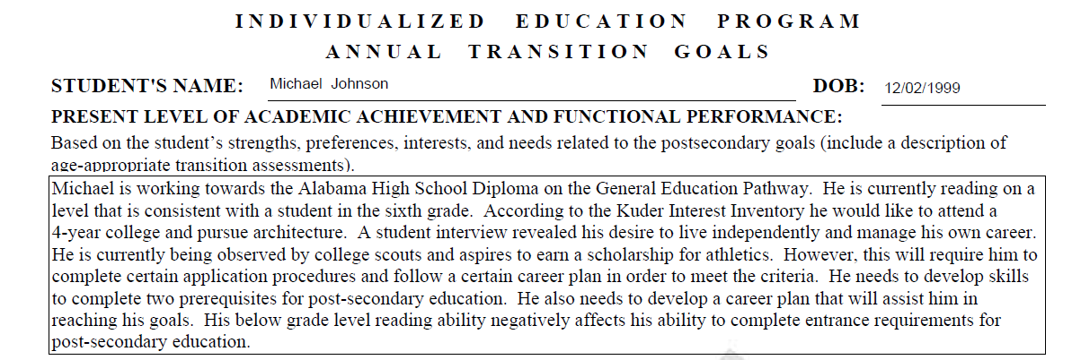

Slide 47
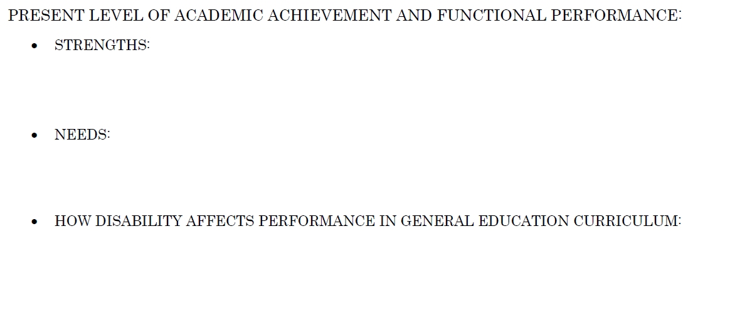
Michael is working towards the Alabama High School Diploma on the General Education Pathway. He is currently reading on a level that is consistent with a student in the sixth grade. According to the Kuder Interest Inventory he would like to attend a 4-year college and pursue architecture. A student interview revealed his desire to live independently and manage his own career. He is currently begin observed by college scouts and aspires to earn a scholarship for athletics.

Slide 48
Michael is working towards the Alabama High School Diploma on the General Education Pathway. He is currently reading on a level that is consistent with a student in the sixth grade. According to the Kuder Interest Inventory he would like to attend a 4-year college and pursue architecture. A student interview revealed his desire to live independently and manage his own career. He is currently begin observed by college scouts and aspires to earn a scholarship for athletics.

Slide 49
However, this will require him to complete certain application procedures and follow a certain career plan in order to meet the criteria. He needs to develop skills to complete two prerequisites for post-secondary education. He also needs to develop a career plan that will assist him in reaching his goals.
Michael is working towards the Alabama High School Diploma on the General Education Pathway. He is currently reading on a level that is consistent with a student in the sixth grade. According to the Kuder Interest Inventory he would like to attend a 4-year college and pursue architecture. A student interview revealed his desire to live independently and manage his own career. He is currently begin observed by college scouts and aspires to earn a scholarship for athletics.

Slide 50
Michael is working towards the Alabama High School Diploma on the General Education Pathway. He is currently reading on a level that is consistent with a student in the sixth grade. According to the Kuder Interest Inventory he would like to attend a 4-year college and pursue architecture. A student interview revealed his desire to live independently and manage his own career. He is currently begin observed by college scouts and aspires to earn a scholarship for athletics.
However, this will require him to complete certain application procedures and follow a certain career plan in order to meet the criteria. He needs to develop skills to complete two prerequisites for post-secondary education. He also needs to develop a career plan that will assist him in reaching his goals.

Slide 51
His below grade level reading ability negatively affects his ability to complete entrance requirements for post-secondary education.
Michael is working towards the Alabama High School Diploma on the General Education Pathway. He is currently reading on a level that is consistent with a student in the sixth grade. According to the Kuder Interest Inventory he would like to attend a 4-year college and pursue architecture. A student interview revealed his desire to live independently and manage his own career. He is currently begin observed by college scouts and aspires to earn a scholarship for athletics.
However, this will require him to complete certain application procedures and follow a certain career plan in order to meet the criteria. He needs to develop skills to complete two prerequisites for post-secondary education. He also needs to develop a career plan that will assist him in reaching his goals.

Slide 52
Michael is working towards the Alabama High School Diploma on the General Education Pathway. He is currently reading on a level that is consistent with a student in the sixth grade. According to the Kuder Interest Inventory he would like to attend a 4-year college and pursue architecture. A student interview revealed his desire to live independently and manage his own career. He is currently begin observed by college scouts and aspires to earn a scholarship for athletics. However, this will require him to complete certain application procedures and follow a certain career plan in order to meet the criteria. He needs to develop skills to complete two prerequisites for post-secondary education. He also needs to develop a career plan that will assist him in reaching his goals. His below grade level reading ability negatively affects his ability to complete entrance requirements for post-secondary education.
Michael is working towards the Alabama High School Diploma on the General Education Pathway. He is currently reading on a level that is consistent with a student in the sixth grade. According to the Kuder Interest Inventory he would like to attend a 4-year college and pursue architecture. A student interview revealed his desire to live independently and manage his own career. He is currently begin observed by college scouts and aspires to earn a scholarship for athletics.
However, this will require him to complete certain application procedures and follow a certain career plan in order to meet the criteria. He needs to develop skills to complete two prerequisites for post-secondary education. He also needs to develop a career plan that will assist him in reaching his goals.
His below grade level reading ability negatively affects his ability to complete entrance requirements for post-secondary education.

Slide 54
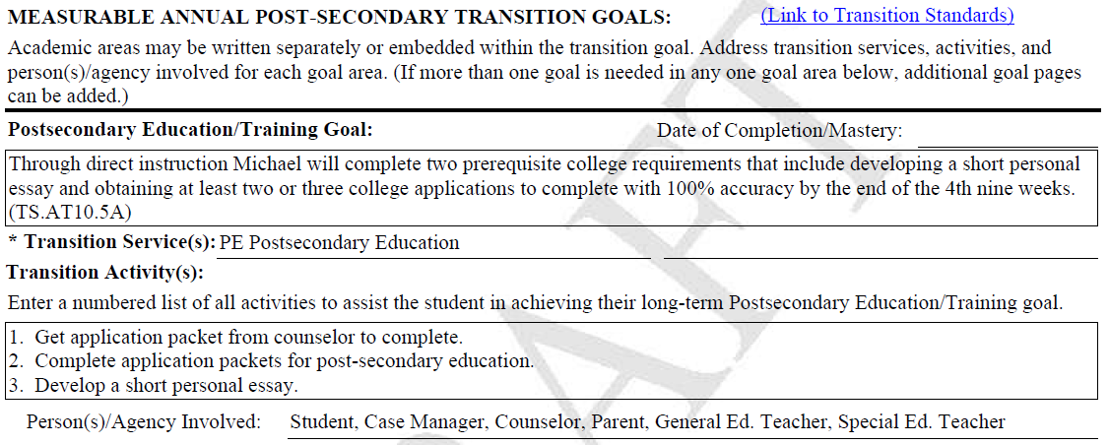

Slide 55
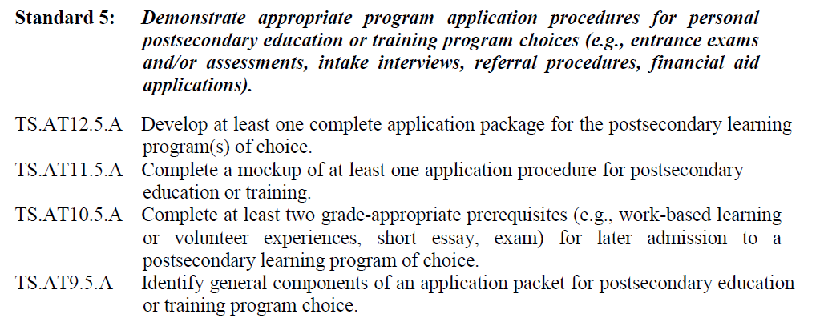

Slide 56
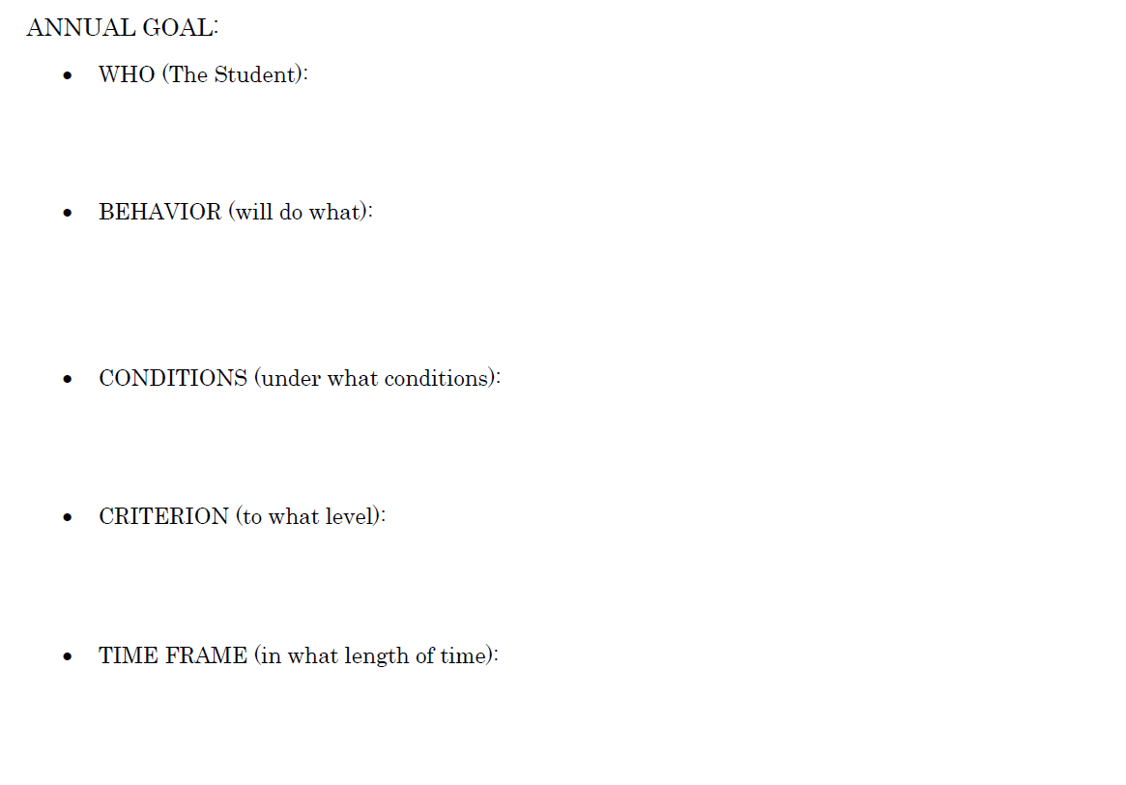
Michael
will complete two prerequisite college requirements that include developing a short personal essay and obtaining at least two or three college applications to complete
Through direct instruction
with 100% accuracy
by the end of the 4th nine weeks. (TS.AT10.5A)

Slide 57
Through direct instruction, Michael will complete two prerequisite college requirements that include developing a short personal essay and obtaining at least two or three college applications to complete with 100% accuracy by the end of the 4th nine weeks. (TS.AT10.5A)

Slide 59
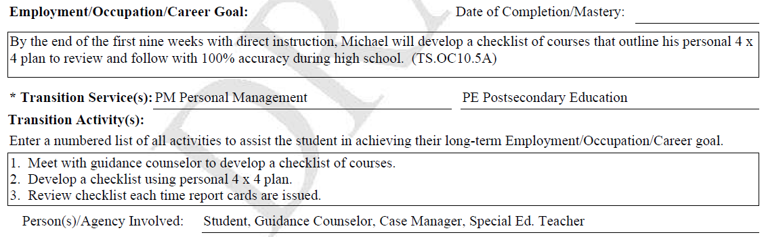

Slide 60
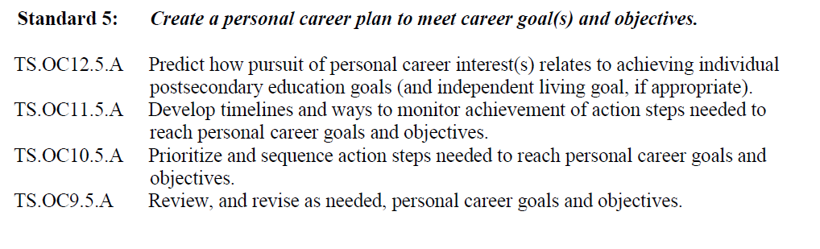

Slide 61
Michael
will develop a checklist of courses that outline his personal 4 x 4 plan to review and follow during high school.
with direct instruction
with 100% accuracy
by the end of the first nine weeks (TS.OC10.5A)

Slide 62
By the end of the first nine weeks with direct instruction, Michael will develop a checklist of course that outline his personal 4 x 4 plan to review and follow with 100% accuracy during high school. (TS.OC10.5)

Slide 64
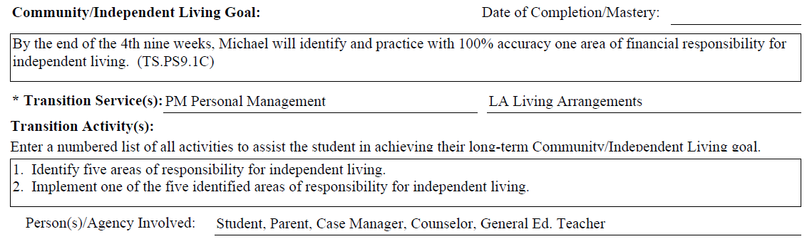

Slide 65
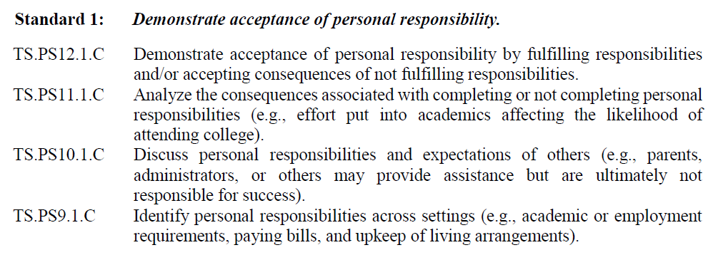

Slide 66
Michael
will identify and practice one area of financial responsibility for independent living.
with direct instruction
with 100% accuracy
By the end of the first nine weeks (TS.PS9.1C)

Slide 67
By the end of the 4th nine weeks with direct instruction, Michael will identify and practice with 100% accuracy one area of financial responsibility for independent living. (TS.PS9.1C)

Slide 68
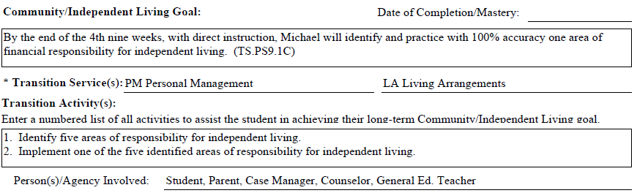

Slide 69
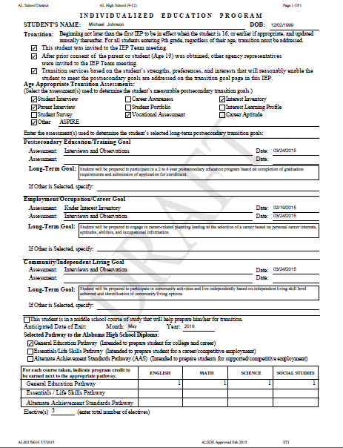
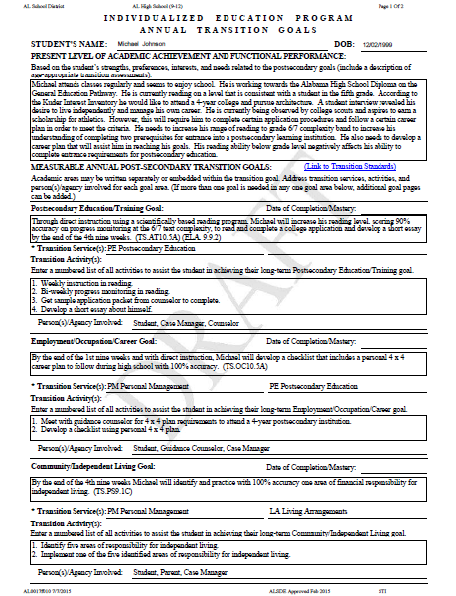

Slide 70
Annual Goal Page(s)
STANDARDS-BASED IEP
Notes:
Facilitator’s Notes:

Slide 71
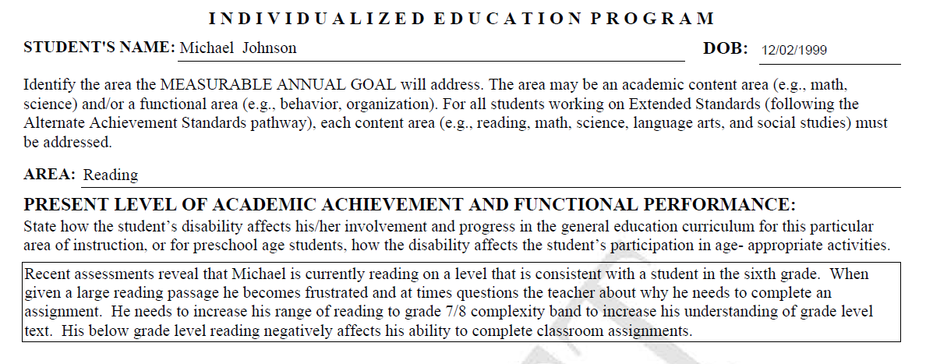

Slide 72
Recent assessments reveal that Michael is currently reading on a level that is consistent with a student in the sixth grade.

Slide 73
Recent assessments reveal that Michael is currently reading on a level that is consistent with a student in the sixth grade.

Slide 74
When given a large reading passage he becomes frustrated and at times questions the teacher about why he needs to complete an assignment. He needs to increase his ranges of reading to grade 7/8 complexity band to increase his understanding of grade level text.
Recent assessments reveal that Michael is currently reading on a level that is consistent with a student in the sixth grade.

Slide 75
Recent assessments reveal that Michael is currently reading on a level that is consistent with a student in the sixth grade.
When given a large reading passage he becomes frustrated and at times questions the teacher about why he needs to complete an assignment. He needs to increase his ranges of reading to grade 7/8 complexity band to increase his understanding of grade level text.

Slide 76
His below grade level reading negatively affects his ability to complete classroom assignments.
Recent assessments reveal that Michael is currently reading on a level that is consistent with a student in the sixth grade.
When given a large reading passage he becomes frustrated and at times questions the teacher about why he needs to complete an assignment. He needs to increase his ranges of reading to grade 7/8 complexity band to increase his understanding of grade level text.

Slide 77
Recent assessments reveal that Michael is currently reading on a level that is consistent with a student in the sixth grade. When given a large reading passage he becomes frustrated and at times questions the teacher about why he needs to complete an assignment. He needs to increase his ranges of reading to grade 7/8 complexity band to increase his understanding of grade level text. His below grade level reading negatively affects his ability to complete classroom assignments.
Recent assessments reveal that Michael is currently reading on a level that is consistent with a student in the sixth grade.
When given a large reading passage he becomes frustrated and at times questions the teacher about why he needs to complete an assignment. He needs to increase his ranges of reading to grade 7/8 complexity band to increase his understanding of grade level text.
His below grade level reading negatively affects his ability to complete classroom assignments.

Slide 79
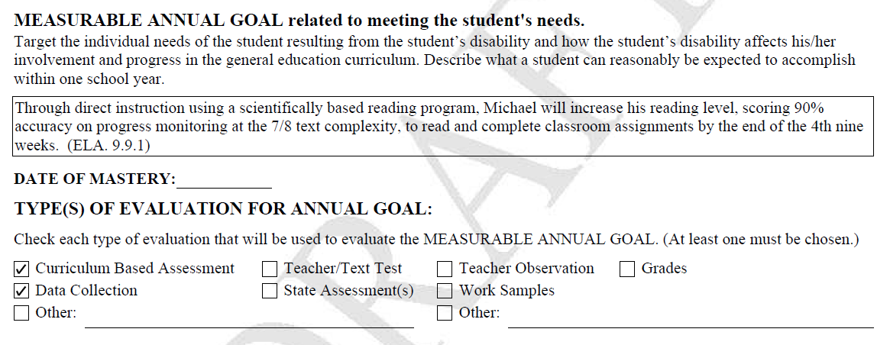

Slide 80


Slide 81
Michael
will increase his reading level, to read and complete classroom assignments
Through direct instruction using a scientifically based reading program,
scoring 90% accuracy on progress monitoring at the 7/8 text complexity
By the end of the 4th nine weeks (ELS 9.9.1)

Slide 82
Through direct instruction using a scientifically based reading program, Michael will increase his reading level, scoring 90% accuracy on progress monitoring at the 7/8 text complexity, to read and complete classroom assignments by the end of the 4th nine weeks. (ELA 9.9.1)

Slide 84
Special Education and Related Service(s)
STANDARDS-BASED IEP
Notes:
Facilitator’s Notes:

Slide 85


Slide 86


Slide 87



Slide 88


Slide 89
OR

Slide 90



Slide 91



Slide 92
Signature Page
STANDARDS-BASED IEP
Notes:
Facilitator’s Notes:

Slide 93


Slide 94


Slide 95



Slide 96


Slide 97


Slide 98
Notice of Proposal or Refusal to Take Action
STANDARDS-BASED IEP
Notes:
Facilitator’s Notes:

Slide 99


Slide 100


Slide 101


Slide 102


Slide 103
Persons Responsible for IEP Implementation
STANDARDS-BASED IEP
Notes:
Facilitator’s Notes:

Slide 104


Slide 105


Slide 106

Regional Specialist
Stephanie Frucci 1 Clare Ward 7
Shelia Bolling 2 Susan Goldthwaite 8
Regina Sankey 3 Curtis Gage 9
Denise Gilham 4 Tina Sanders 10
Cynthia Augustine 5 Diann Jones 11A
Brian Dunn 6 Joe Eiland 11B
Shirley Farrell-(All Regions)
Revised 1/16

